Slide 1

Welcome to

Slide 2

Learning Objective for talk
Understand what cryptographic hashes are and why they matter
Know core Hashcat attack modes and how to pick wordlists/rules
Configure basic tuning for a GPU-based cracking workflow

Slide 3


Agenda
History & why passwords fail
What is a hash? Types & examples
Hashcat: modes and syntax
Wordlists & rule files
Performance tips & special cases
Live demo and questions
Notes:
Emphasize practical takeaways. Tell audience they’ll see commands and a short demo

Slide 4

Quick history of Passwords
Passwords were originally used by the romans to secure access to guarded areas
Used heavily during prohibition, often required being spoken softly, thus the term speakeasy
First use of passwords on a computer was 1960 at MIT, also the first breach two years later
Robert Morris and Ken Thompson coin the term “salt”, used when adding extra characters on a password to increase complexity

Slide 5
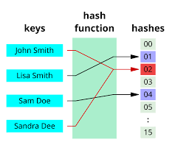
What are Hashes
Cryptographic function that takes input value (Password) is Pseudo-random, but deterministic
If exposed in a data breach, doesn’t directly give plaintext passwords
Can still be “cracked” but often the difficulty of the hash function is hardened via added complexity in the hash function itself
Collisions may occur, but all popular
algos used today have tiny odds of doing so

Slide 6
Identifying hashes, and salts
What a salt is: a per-password random value appended/prepended to the password before hashing
Why salts matter: stop rainbow tables and force per-password brute force, else precomputed md5 tables could sweep every password
Two common salt behaviors: embedded (bcrypt, modular formats) vs separate (hash:salt files).
Hash:salt is what is seen more frequently in NCL
CHECK HASHCAT DOCS, pretty useful
NTLM
8846f7eaee8fb117ad06bdd830b7586c
SHA256
5e884898da28047151d0e56f8dc6292773603d0d6aabbddf : s4lt123
(hash) : (salt)

Slide 7
Common hash types + tradeoffs
MD5, SHA1, NTLM
Fast to hash
Older/outdated, still in legacy systems
Popular for CTFs and demonstrations
Bcrypt, scrypt, Argon2
Slow to hash
Newer, preferred by new projects
Better for Blue Team security

Slide 8

Example hashing speeds (RTX 3090)
MD5 | 66,858.7 MH/s
SHA1 | 21,247.4 MH/s
NTLM | 118.4 GH/s
Bcrypt (32 iterations) | 96,070 H/s
Scrypt (16384 iter) | 3850 H/s
Argon2 | Roughly 850 H/s (found online)

Slide 9
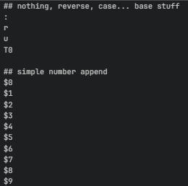
Rule files - mutate the candidates efficiently
Apply deterministic rules to each candidate (append, prepend, case, leet)
Common examples are best64.rule, dive.rule, and OneRuleToRuleThemAll.rule
How to use
“-r <location/ruleFile>”
Showing under the hood
hashcat --stdout name.txt -r rule/best64.rule | head -n 20
Cheaper and better than adding to wordlists!

Slide 10
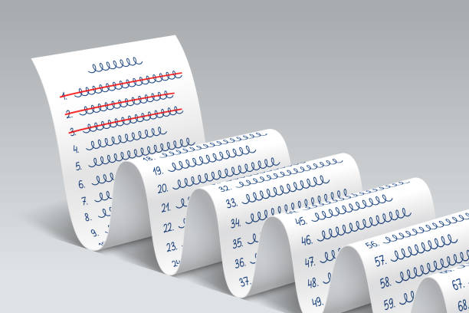
Wordlists
Some common wordlists are rockyou, seclists, crackstation
They are generally HUGE compilations of compiled passwords that have been obtained from prior leaks and breaches
Great for sniffing out weak passwords, whether short, small in variety, or intuitive
Command “<location/list.txt>”
Hashcat doesn’t need a flag for candidate list, since it requires it to function

Slide 11
Piping / streaming
—stdout and –stdin are two powerful flags that let you pipe data in and out of hashcat to meet your needs for custom jobs
–stdin
Lets you pipe in candidates for your attack,
–stdout
Pipes candidates out instead of hashing
Useful for niche challenges that don’t fit

Slide 12
Attack modes
Use -a <#>
Dictionary 0, combination 1, mask 3, hybrid (mask + wordlist) 6/7
Good workflow to think of is targeted -> rules -> combos -> mask
hashcat -m 1000 -a 3 hashes.txt ?l?l?l?l?d?d No wordlist, just the mask itself
hashcat -m 1000 -a 6 hashes.txt wordlist.txt ?d?d mask is appended on end, ?d?d is 0-99
hashcat -m 1000 -a 1 hashes.txt list1.txt list2.txt combine two lists

Slide 13
Performance
Performance scales pretty linearly for straight rule files
Time = ListSize x RuleSize x Hashing Algorithm
Better hardware / joined hardware via hashtopolis can make it quicker

Slide 14
fun
Hashcat -m 20 -a 0 <wordlist> -r <rule>

Slide 15
Resources
https://hashcat.net/hashcat/
https://github.com/n0kovo/hashcat-rules-collection

Slide 16
Sources
https://newsroom.cisco.com/c/r/newsroom/en/us/a/y2022/m11/security-timeline.html

